Slide 1
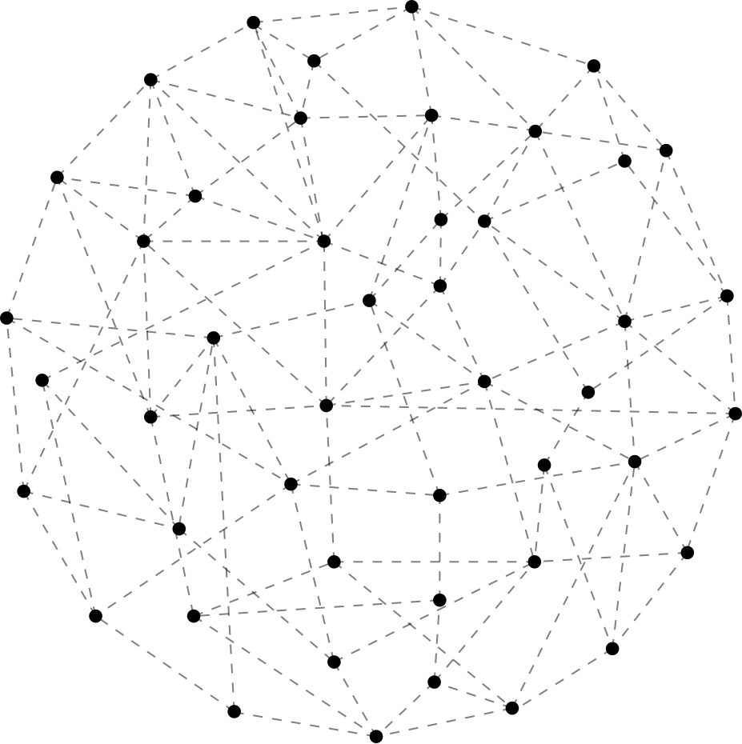




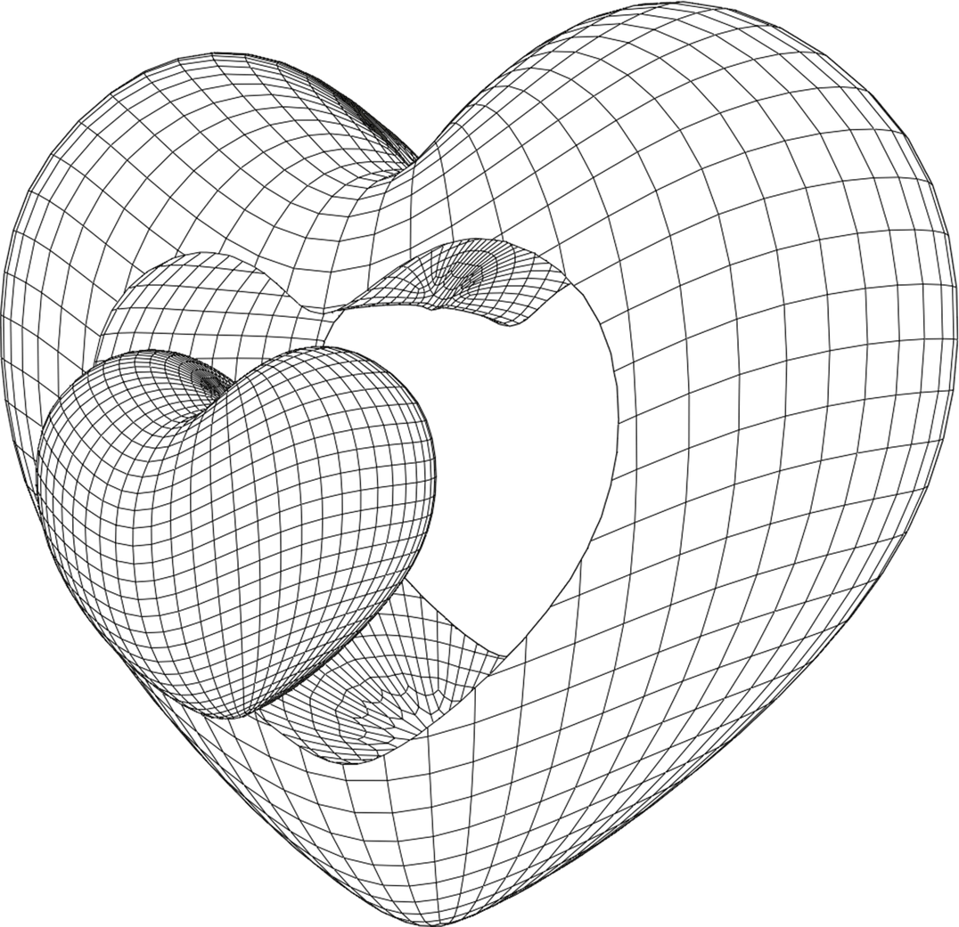

WASHINGTON
State
University
SPRING 2024
EXPLORING THE ETHEREUM BLOCKCHAIN THROUGH NETWORK ANALYSIS
CPTS 591
CHINMAY CHABBI 011858333
Yi Chou
011744816

Slide 2

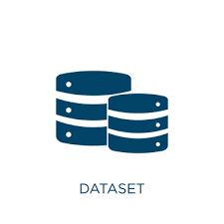




DATASET
Number of Datasets: 2
Nodes: Accounts
Edge: Transactions
Transaction data from the Ethereum blockchain. Recorded in the year 2020. providing a base for analyzing the structure and dynamics of cryptocurrency exchanges

Slide 3
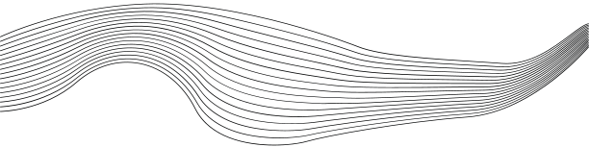
NETWORK ANALYSIS
Analysis helps us provide a comprehensive picture that helps stakeholders in making informed decisions, enhances our theoretical understanding of network science and understand how network operates.
01
NETWORK STRUCTURE ANALYSIS
02
CENTRALITY/ NODE IMPORTANCE
03
COMMUNITY DETECTION
04
NETWORK MOTIFS AND SUBGRAPH
05
INFLUENCE ANALYSIS

Slide 4

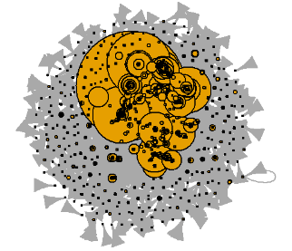
NETWORK STRUCTURE ANALYSIS
Definition: Network structure analysis assesses the overarching layout and connectivity of a network by examining properties like density, diameter, average path length, and clustering coefficients, revealing insights into the network’s efficiency and robustness.
Number of Nodes: 3974
Number of Edges: 10000
Minimum Degree: 1
Maximum Degree: 2742
Average Path Length: 5.3551
Diameter: 18
Global Clustering Coefficient: 0.0019
Algebraic Connectivity (λ2): 518.8491
Largest Eigenvalue (λn): -6.8936
Density: 0.0006
Node Size by Degree

Slide 5
CENTRALITY/NODE IMPORTNACE
Top nodes for each centrality measure
Definition: Centrality analysis quantifies the importance or influence of nodes within a network using metrics such as degree, betweenness, closeness, and eigenvector centrality, to identify key actors and pivotal entities in a network structure.
Degree: 0xf20b9e713a33f61fa38792d2afaf1cd30339126a
Eccentricity: 0xb5d6c0ca5529b6e0a7f327cbed8276cabc370cd8
Closeness: 0x63c5608caea858240d661d9bfc811c62838cdf15
Betweenness: 0x3f5ce5fbfe3e9af3971dd833d26ba9b5c936f0be
PageRank: 0x3f5ce5fbfe3e9af3971dd833d26ba9b5c936f0be
Authority: 0xf20b9e713a33f61fa38792d2afaf1cd30339126a
Hub: 0x1f573d6fb3f13d689ff844b4ce37794d79a7ff1c
Eigenvector: 0xf20b9e713a33f61fa38792d2afaf1cd30339126a

Slide 6
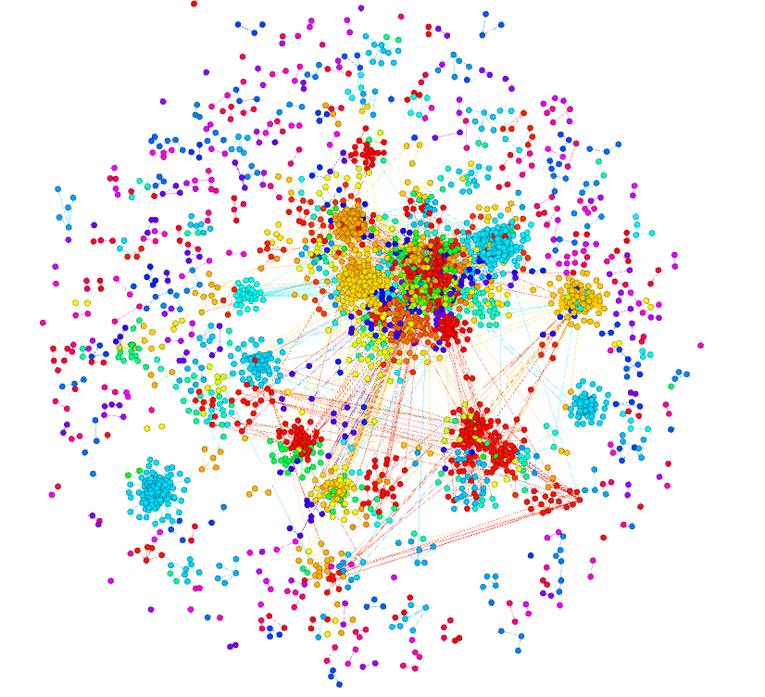
COMMUNITY DETECTION
Definition: Community detection identifies densely connected groups within a network, using algorithms to segment the network into clusters that exhibit higher internal than external connectivity, indicative of functional or social subdivisions.
Modularity of community structure: 0.7403053
Communities displayed by colors

Slide 7
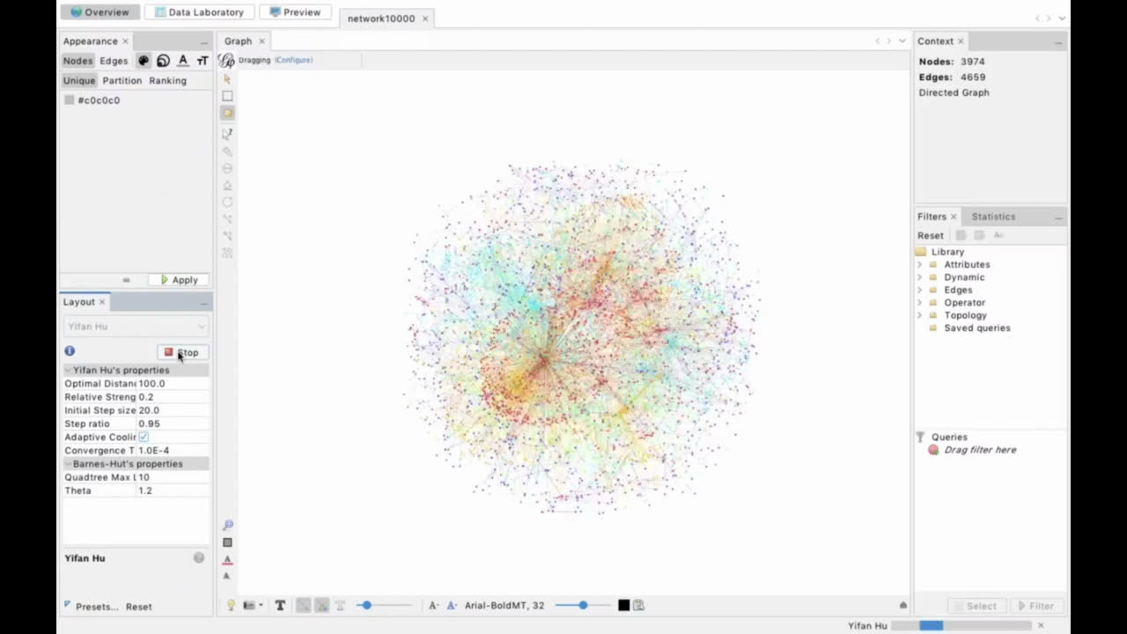

Slide 8

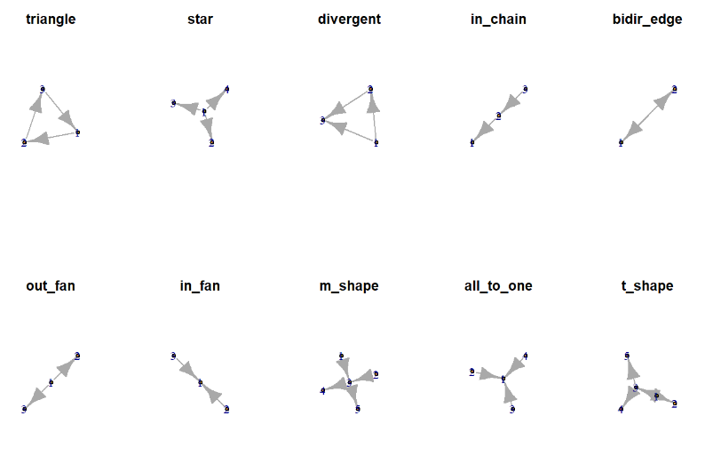
NETWORK MOTIFS AND SUBGRAPH ANALYSIS
Motif ID - Frequency
Triangle - 477
Star - 75,659,880
Divergent - 252
In Chain - 126,408
Bidir Edge - 522
Out Fan - 338,984
In Fan - 186,878
M Shape - 386,272,452
All to One - 62,793,072
T Shape - 51,228,960

Slide 9
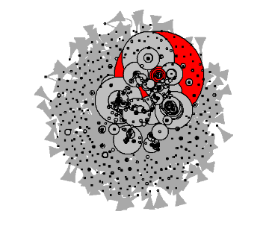
INFLUENCE ANALYSIS
Definition: Network motifs and subgraph analysis involve identifying and examining recurrent and statistically significant patterns or subgraphs within a network, which are indicative of common functional or structural roles.
Top 5 influential nodes based on
Eigenvector Centrality: 4, 3, 144, 175, 634

Slide 10

CONCLUSION

Slide 11

REFERENCES
Etherscan.io. (2020). Ethereum blockchain explorer. Available at: https://etherscan.io/ (Accessed: Date).
Leskovec, J., Rajaraman, A., & Ullman, J.D. (2014). Mining of Massive Datasets. Cambridge University Press.
Newman, M.E.J. (2010). Networks: An Introduction. Oxford University Press.
Barabási, A.-L. (2016). Network Science. Cambridge University Press.
SNAP: Stanford Network Analysis Project. (2020). Stanford University. Available at: https://snap.stanford.edu/

